Slide 1
LightGBM Regression Algorithm
An overview of LightGBM for regression tasks

Slide 2

Overview of LightGBM
LightGBM (Light Gradient Boosting Machine) is a fast, distributed, high-performance gradient boosting framework based on decision tree algorithms. It is designed for efficiency and scalability, and is widely used for regression, classification, and ranking tasks.

Slide 3
How LightGBM Works
LightGBM builds trees using a leaf-wise approach rather than a level-wise approach. It chooses the leaf with the maximum delta loss to grow, which can lead to better accuracy. It uses histogram-based algorithms for faster computation and supports categorical features natively.

Slide 4

Key Parameters
- n_estimators: Number of boosting iterations
- learning_rate: Shrinks the contribution of each tree
- max_depth: Maximum depth of a tree
- min_data_in_leaf: Minimum number of data points in a leaf
- objective: Defines the loss function (e.g., 'regression')

Slide 5

Python Example
!pip install lightgbm
from lightgbm import LGBMRegressor
regressor =LGBMRegressor(n_estimators=100, learning_rate=0.1, max_depth=3, min_data_in_leaf=1, min_data_in_bin=1)
regressor.fit(X_train, y_train)

Slide 6
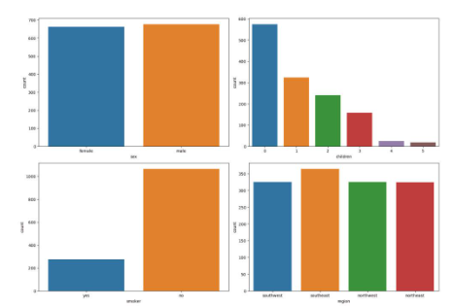

Slide 7
Use Cases
- Predicting house prices
- Forecasting sales
- Modeling customer lifetime value
- Any regression task with large datasets and high dimensionality

